Slide 1
Chapter 21: Architecture Evaluation
Pingjian Zhang
School of Software Engineering, SCUT
2018

Slide 2
Chapter Outline
Evaluation Factors
The Architecture Tradeoff Analysis Method (ATAM)
Lightweight Architecture Evaluation
Summary

Slide 3
Three Forms of Evaluation
Evaluation by the designer within the design process.
Evaluation by peers within the design process.
Analysis by outsiders once the architecture has been designed.

Slide 4
Evaluation by the Designer
Every time the designer makes a key design decision or completes a design milestone, the chosen and competing alternatives should be evaluated.
Evaluation by the designer is the “test” part of the “generate-and-test” approach to architecture design.
How much analysis? This depends on the importance of the decision. Factors include:
The importance of the decision.
The number of potential alternatives.
Good enough as opposed to perfect.

Slide 5
Peer Review
Architectural designs can be peer reviewed, just as code can.
A peer review can be carried out at any point of the design process where a candidate architecture, or at least a coherent reviewable part of one, exists.
Allocate at least several hours and possibly half a day.

Slide 6
Peer Review Steps
Steps:
The reviewers determine a number of quality attribute scenarios to drive the review.
The architect presents the portion of the architecture to be evaluated.
For each scenario, the designer walks through the architecture and explains how the scenario is satisfied.
Potential problems are captured.

Slide 7
Analysis by Outsiders
Outside evaluators can cast an objective eye on an architecture.
“Outside” is relative; this may mean
outside the development project
outside the business unit where the project resides but within the same company
outside the company altogether.
Outsiders are chosen because they possess specialized knowledge or experience, or long experience successfully evaluating architectures.
Managers tend to be more inclined to listen to problems uncovered by an outside team.

Slide 8
Contextual Factors for Evaluation
What artifacts are available?
Who sees the results?
Who performs the evaluation?
Which stakeholders will participate?
What are the business goals?

Slide 9
The Architecture Tradeoff Analysis Method
The Architecture Tradeoff Analysis Method (ATAM) has been used for over a decade to evaluate software architectures.
The ATAM is designed so that evaluators need not be familiar with the architecture or its business goals, the system need not yet be constructed, and there may be a large number of stakeholders.

Slide 10
Participants in the ATAM
The evaluation team.
External to the project whose architecture is being evaluated.
Three to five people; a single person may adopt several roles in an ATAM.
Project decision makers.
They usually include the PM, customer.
The architect is always included.
Architecture stakeholders.
Stakeholders include developers, testers, integrators, maintainers, performance engineers, users, builders, and, possibly, others.

Slide 11
ATAM Evaluation Team Roles
Role | Responsibilities
Team leader | Sets up the evaluation; coordinates with client, making sure client’s needs are met; establishes evaluation contract; forms evaluation team; sees that final report is produced and delivered (although the writing may be delegated)
Evaluation leader | Runs evaluation; facilitates elicitation of scenarios; administers scenario selection/prioritization process; facilitates evaluation of scenarios against architecture; facilitates on-site analysis
Scenario scribe | Writes scenarios on flipchart or whiteboard during scenario elicitation; captures agreed-on wording of each scenario, halting discussion until exact wording is captured
Proceedings scribe | Captures proceedings in electronic form on laptop or workstation: raw scenarios, issue(s) that motivate each scenario (often lost in the wording of the scenario itself), and resolution of each scenario when applied to architecture(s); also generates a printed list of adopted scenarios for handout to all participants
Questioner | Raises issues of architectural interest, usually related to the quality attributes in which he or she has expertise

Slide 12
Outputs of the ATAM
A concise presentation of the architecture.
Articulation of the business goals.
Prioritized quality attribute requirements expressed as quality attribute scenarios.
A set of risks and nonrisks.
A risk is defined as an architectural decision that may lead to undesirable consequences in light of quality attribute requirements.
A nonrisk is an architectural decision that, upon analysis, is deemed safe.
The identified risks form the basis for an architectural risk mitigation plan.

Slide 13
Outputs of the ATAM
A set of risk themes.
Mapping of architectural decisions to quality requirements.
A set of identified sensitivity and tradeoff points.

Slide 14
Intangible Outputs
There are also intangible results of an ATAM-based evaluation. These include
a sense of community on the part of the stakeholders
open communication channels between the architect and the stakeholders
a better overall understanding on the part of all participants of the architecture and its strengths and weaknesses.
While these results are hard to measure, they are no less important than the others and often are the longest-lasting.

Slide 15
Phases of the ATAM
Phase | Activity | Participants | Typical duration
0 | Partnership and preparation: Logistics, planning, stakeholder recruitment, team formation | Evaluation team leadership and key project decision-makers | Proceeds informally as required, perhaps over a few weeks
1 | Evaluation: Steps 1-6 | Evaluation team and project decision-makers | 1-2 days followed by a hiatus of 2-3 weeks
2 | Evaluation: Steps 7-9 | Evaluation team, project decision makers, stakeholders | 2 days
3 | Follow-up: Report generation and delivery, process improvement | Evaluation team and evaluation client | 1 week

Slide 16
Step 1: Present the ATAM
The evaluation leader presents the ATAM to the assembled project representatives.
Using a standard presentation, the leader describes the ATAM steps in brief and the outputs of the evaluation.

Slide 17
Step 2: Present Business Drivers
Everyone involved in the evaluation needs to understand the context for the system and the primary business drivers motivating its development.
In this step, a project decision maker presents a system overview from a business perspective.
The presentation should describe the following:
The system’s most important functions
Any relevant technical, managerial, economic, or political constraints
The business goals and context as they relate to the project
The major stakeholders
The architectural drivers (that is, ASR)

Slide 18
Step 3: Present the Architecture
The lead architect (or architecture team) makes a presentation describing the architecture.
The architect covers technical constraints, and other systems with which the system must interact.
The architect describes the architectural approaches used to meet the requirements.
The architect should present the views that help to reason about the most important quality attribute concerns of the system.

Slide 19
Step 4: Identify Architectural Approaches
The ATAM focuses on analyzing an architecture by understanding its architectural approaches, especially patterns and tactics.
The evaluation team catalogs the patterns and tactics that have been identified.
The list is publicly captured and will serve as the basis for later analysis.

Slide 20
Step 5: Generate Utility Tree
The important quality attribute goals for the architecture under consideration were named in step 2.
In this step, the evaluation team works with the project decision makers to identify, prioritize, and refine the system’s most important quality attribute goals.
These are expressed as scenarios, which populate the leaves of the utility tree.
The scenarios are assigned a rank of importance (High, Medium, Low).

Slide 21
Step 6: Analyze Architectural Approaches
The evaluation team examines the highest-ranked scenarios one at a time; the architect is asked to explain how the architecture supports each one.
Evaluation team members probe for the architectural approaches that the architect used to carry out the scenario.
Along the way, the evaluation team documents the relevant architectural decisions and identifies and catalogs their risks, nonrisks, sensitivity points, and tradeoffs.
Notes:
Examples:
Risk: The frequency of heartbeats affects the time in which the system can detect a failed component. Some assignments will result in unacceptable values of this response.
Sensitivity point: The number of simultaneous database clients will affect the number of transactions that a database can process per second.
Tradeoff: The heartbeat frequency determines the time for detecting a fault. Higher frequency leads to better availability but consumes more processing time and communication bandwidth (potentially reducing performance).

Slide 22
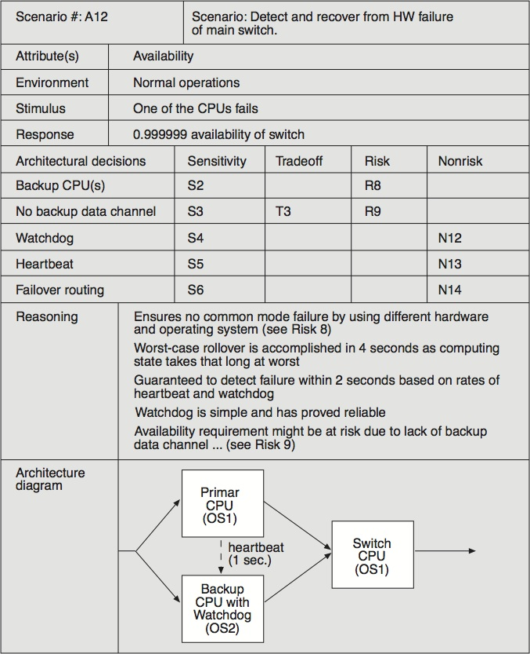
Example of an Analysis

Slide 23
Step 7: Brainstorm and Prioritize Scenarios
The stakeholders brainstorm scenarios that are operationally meaningful with respect to the stakeholders’ individual roles.
The purpose of scenario brainstorming is to take the pulse of the larger stakeholder community.
Once the scenarios have been collected, they are prioritized by voting.
The list of prioritized scenarios is compared with those from the utility tree exercise.
Notes:
A maintainer will likely propose a modifiability scenario
A user will probably come up with a scenario that expresses useful functionality or ease of operation
A quality assurance person will propose a scenario about testing the system or being able to replicate the state of the system leading up to a fault.
If they agree, it indicates good alignment between what the architect had in mind and what the stakeholders actually wanted.
If additional driving scenarios are discovered—and they usually are—this may itself be a risk, if the discrepancy is large. This would indicate that there was some disagreement in the system’s important goals between the stakeholders and the architect.

Slide 24
Step 8: Analyze Architectural Approaches
In this step the evaluation team performs the same activities as in step 6, using the highest-ranked, newly generated scenarios.
The evaluation team guides the architect in the process of carrying out the highest ranked new scenarios.
The architect explains how relevant architectural decisions contribute to realizing each one.
This step might cover the top 5-10 scenarios, as time permits.

Slide 25
Step 9: Present Results
The evaluation team confers privately to group risks into risk themes, based on some common underlying concern or systemic deficiency.
For each risk theme, the evaluation team identifies which of the business drivers listed in step 2 are affected.
This elevates the risks that were uncovered to the attention of management, who cares about the business drivers.
Notes:
For example, a group of risks about inadequate or out-of-date documentation might be grouped into a risk theme stating that documentation is given insufficient consideration.
A group of risks about the system’s inability to function in the face of various hardware and/or software failures might lead to a risk theme about insufficient attention to backup capability or providing high availability.

Slide 26
Step 9: Present Results
The collected information from the evaluation is summarized and presented to stakeholders.
The following outputs are presented:
The architectural approaches documented
The set of scenarios and their prioritization from the brainstorming
The utility tree
The risks discovered
The nonrisks documented
The sensitivity points and tradeoff points found
Risk themes and the business drivers threatened by each one

Slide 27
Lightweight Architectural Evaluation
An ATAM is a substantial undertaking.
It requires some 20 to 30 person-days of effort.
We have developed a Lightweight Architecture Evaluation method, based on the ATAM, for smaller, less risky projects.
May take place in a single day, or even a half-day meeting.
May be carried out entirely by members internal to the organization.
The steps and phases of a Lightweight Architecture Evaluation can be carried out more quickly.

Slide 28
Typical Agenda: 4-6 Hours
Step | Time | Notes
1. Present the ATAM | 0 hours | Participants already familiar with process.
2. Present business drivers | 0.25 hours | The participants are expected to understand the system and its business goals and their priorities. A brief review ensures that these are fresh in everyone’s mind and that there are no surprises.
3. Present architecture | 0.5 hours | All participants are expected to be familiar with the system. A brief overview of the architecture, using at least module and C&C views, is presented. 1-2 scenarios are traced through these views.
4. Identify architectural approaches | 0.25 hours | The architecture approaches for specific quality attribute concerns are identified by the architect. This may be done as a portion of step 3.
5. Generate QA utility tree | 0.5- 1.5 hours | Scenarios might exist: part of previous evaluations, part of design, part of requirements elicitation. Put these in a tree. Or, a utility tree may already exist.
6. Analyze architectural approaches | 2-3 hours | This step—mapping the highly ranked scenarios onto the architecture—consumes the bulk of the time and can be expanded or contracted as needed.
7. Brainstorm scenarios | 0 hours | This step can be omitted as the assembled (internal) stakeholders are expected to contribute scenarios expressing their concerns in step 5.
8. Analyze architectural approaches | 0 hours | This step is also omitted, since all analysis is done in step 6.
9. Present results | 0.5 hours | At the end of an evaluation, the team reviews the existing and newly discovered risks, nonrisks, sensitivities, and tradeoffs and discusses whether any new risk themes have arisen.

Slide 29
Summary
If a system is important enough for you to explicitly design its architecture, then that architecture should be evaluated.
The number of evaluations and the extent of each evaluation may vary from project to project.
A designer should perform an evaluation during the process of making an important decision.
Lightweight evaluations can be performed several times during a project as a peer review exercise.
The ATAM is a comprehensive method for evaluating software architectures.
Lightweight Architecture Evaluation, based on the ATAM, provides an inexpensive, low-ceremony architecture evaluation that can be carried out in an afternoon.

